Slide 1
Security Dashboard from 0 to hero
By Christian Martorella

Slide 2
Whoami
Skyscanner Product Security lead
Microsoft Skype Product Security
theHarvester, Metagoofil, Wfuzz
Python for Web application Pentesters
Big thanks to Zigor Zumalde and Alex Harriss

Slide 3
What is this talk about?
How can you obtain visibility for your Vulnerability management process
How can you make sense out of the data you have about your vulnerabilities
How can you support business decisions, based on that data
How to create a quick dashboard based on Jupyter and Python

Slide 4
Running your Docker container
Install Github desktop https://desktop.github.com/
git clone https://github.com/laramies/devseccon2017.git devseccon
cd devseccon
git pull (if you had cloned the repo yesterday)
make sure you have Docker installed (www.docker.com)
docker pull laramies/alpine:devseccon
docker run -p 8888:8888 -v `pwd`/workdir:/opt laramies/alpine:devseccon
http://localhost:8888/

Slide 5
Why?

Slide 6
Ticketing world

Slide 7
Why?

Slide 8
Issues labeling

Slide 9
Jira Query Language example and labels
=labels in (’security’)

Slide 10
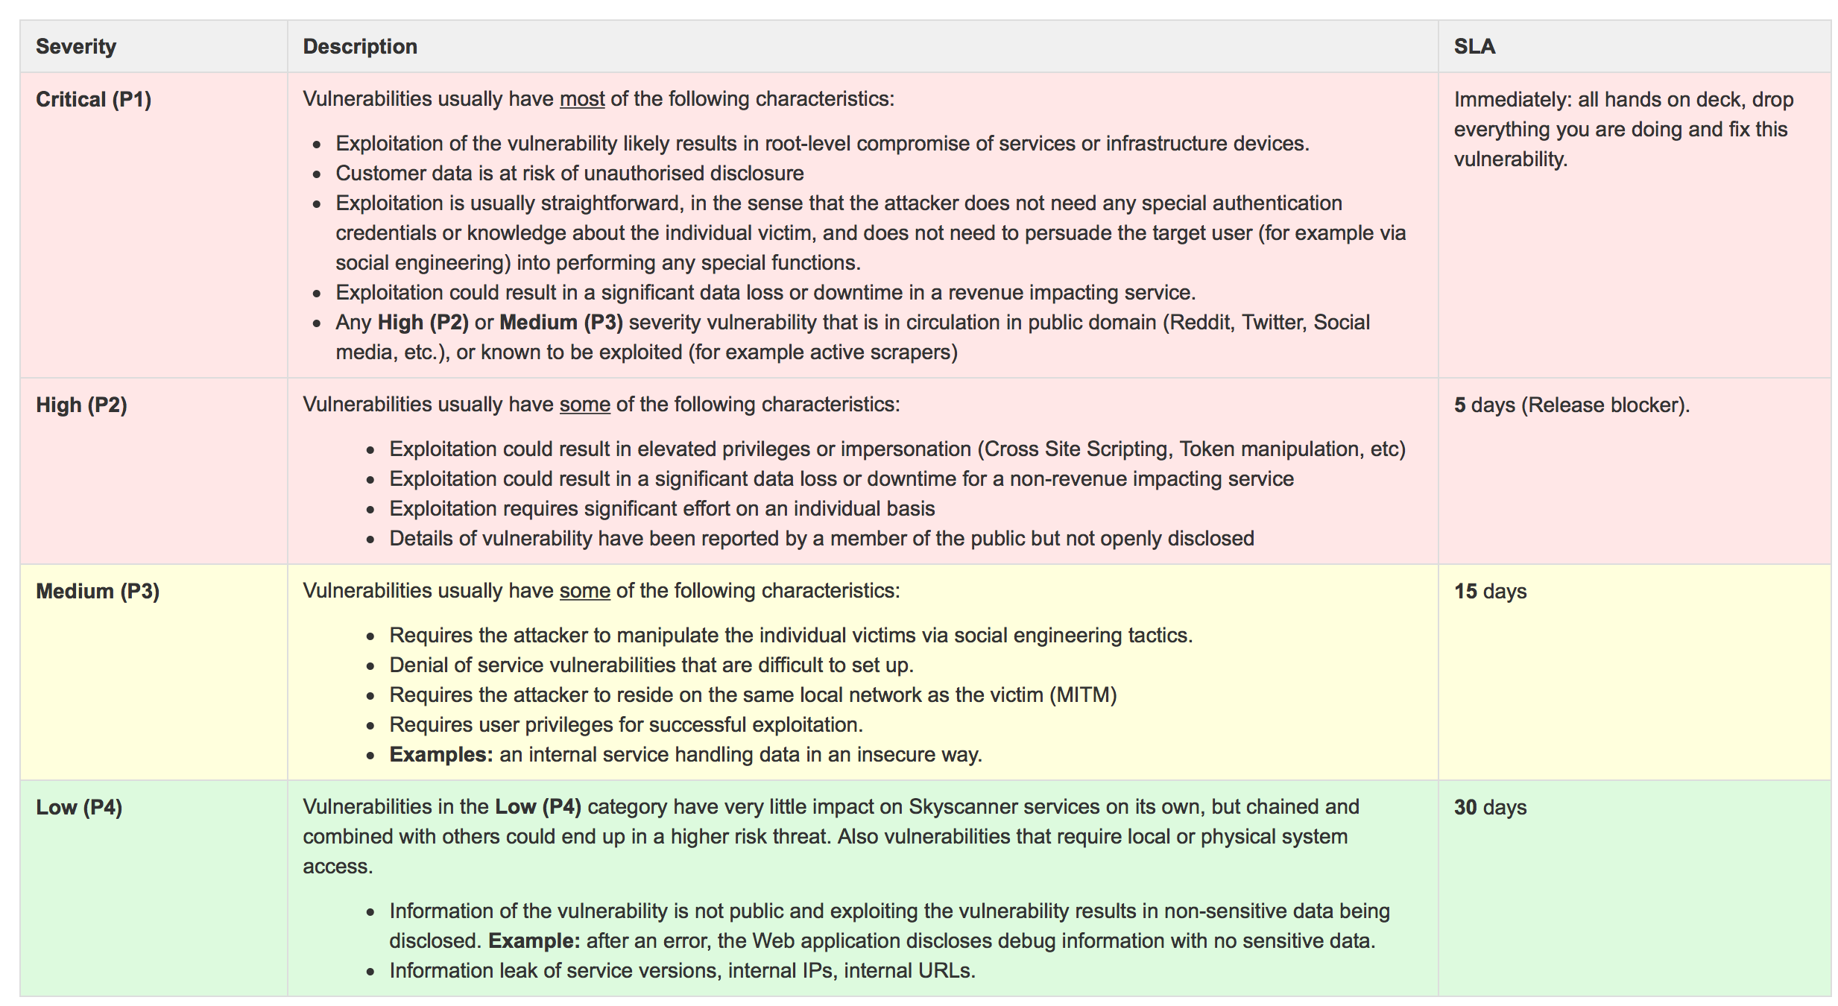
Vulnerabilities scoring system

Slide 11
Vulnerabilities category
Categories:
Session Management
Service Abuse
Sensitive data
Parameter Manipulation
Output validation
Input Validation
Cryptography
Configuration management
Authorisation
Authentication
Audit logs

Slide 12
Vulnerabilities sources
Sources:
Pentest
Manual testing
Threat Modeling
Bugcrowd
Snyk (dependency and OSS components scanning)
SCA (Findsecbugs, Bandit, Sonarqube, etc.)

Slide 13
Organisational structure

Slide 14
Ticket customisation

Slide 15
Overdue SLAs

Slide 16
Risk acceptance

Slide 17
Risk acceptance process in Jira
http://blog.diniscruz.com/2015/12/jira-workflows-for-handing-appsec-risks.html

Slide 19
Jira Dashboards

Slide 20
Hello Python my old friend
Dashboards Extension
Notes:
Pandas = Python for data analysis
Jupyter = The Jupyter Notebook is an open-source web application that allows you to create and share documents that contain live code, equations, visualizations and narrative text.
Matplotlib is a Python 2D plotting library which produces publication quality figures in a variety of hardcopy formats and interactive environments

Slide 21
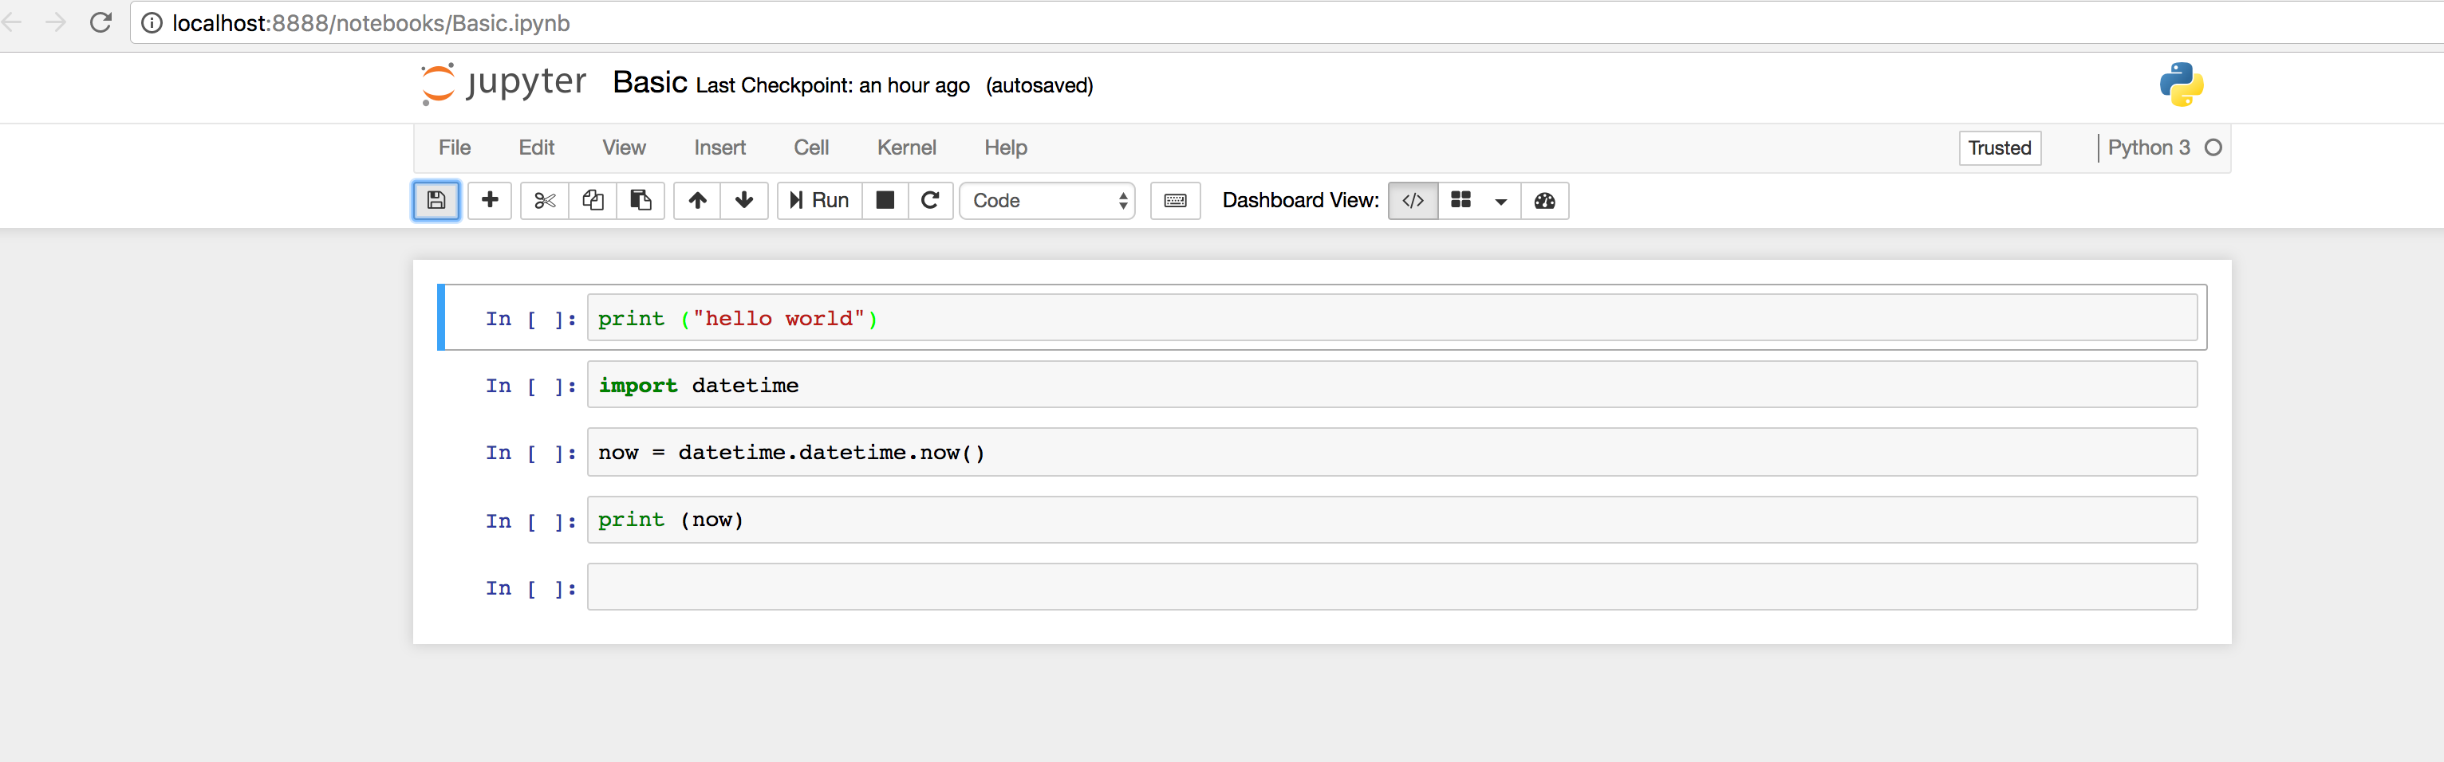
Jupyter Interface

Slide 22
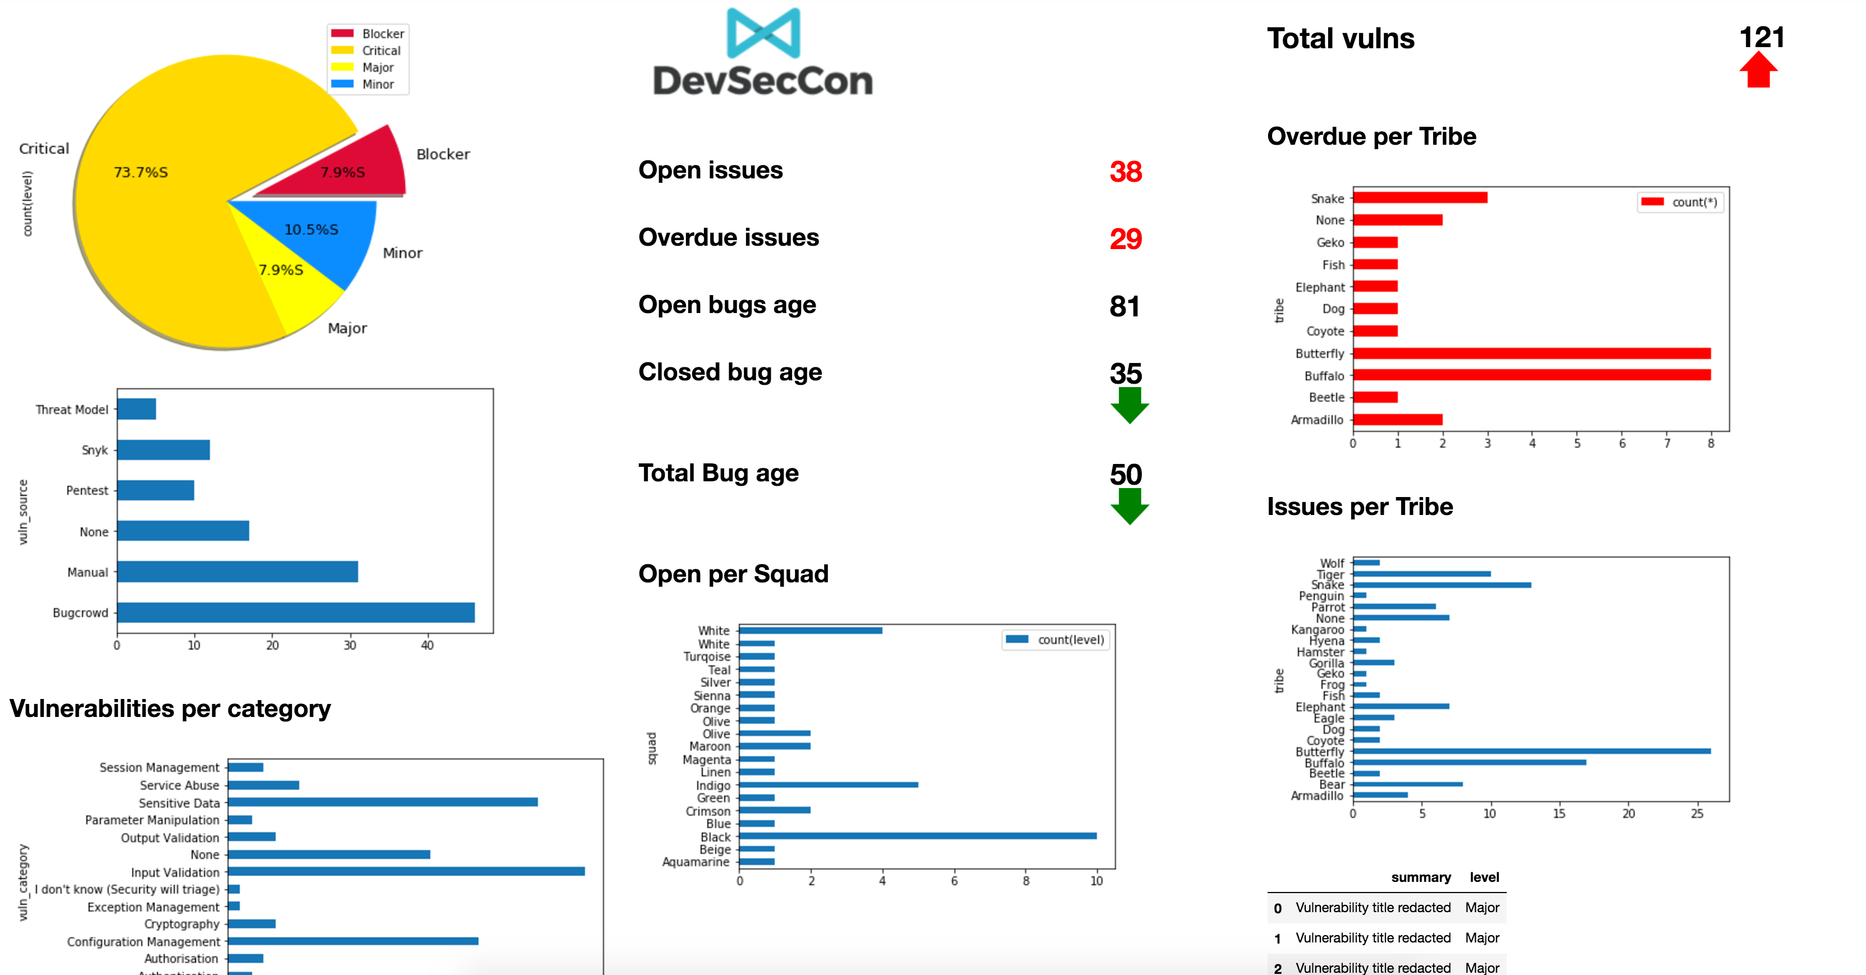

Slide 24
First we need the vulnerabilities data out of Jira
Using the Python Jira library we can pull the tickets from Jira
Example in the Notebook Jira.ipynb
A pre populated sqlite db of vulnerabilities is provided for this workshop.

Slide 25
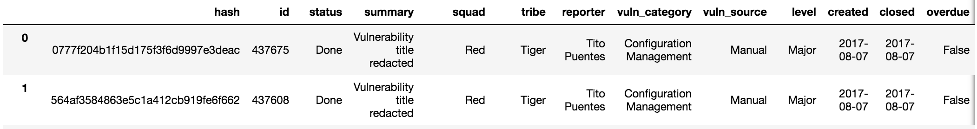
DB structure

Slide 26
Running your Docker container
git clone https://github.com/laramies/devseccon2017.git devseccon
cd devseccon
git pull (if you had cloned the repo yesterday)
make sure you have Docker installed (www.docker.com)
docker pull laramies/alpine:devseccon
docker run -p 8888:8888 -v `pwd`/workdir:/opt laramies/alpine:devseccon
http://localhost:8888/

Slide 27
Basics of Python and Jupyter
Open Notebook ”Basic”

Slide 28
Basics of Pandas
Open Notebook ”SQLandPandas.ipynb”

Slide 29
Creating a Dashboard…
Open Notebook ”mydashboard.ipynb”

Slide 31
Thank you! cmartorella@edge-security.com https://github.com/laramies/devseccon2017

